Slide 1

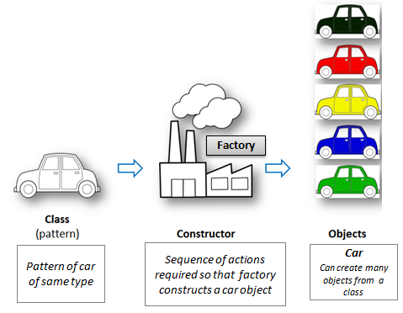
Programming Essential Course
Object-Oriented Programming
● Object-oriented technology models real-world objects.
● Real-world objects are things around you, such as:
table, television, chair, etc.
Class
Object
Inheritance
OOP
Polymorphism
Encapsulation
Data Abstraction

Slide 2
Advantages of OOP
Object-oriented programming fosters reusability.
The modular approach used in object-oriented programming
results in highly maintainable code.
In object-oriented programming, every class has a specific task.
Data encapsulation adds an extra layer of security to the program
developed using the object-oriented approach.

Slide 3
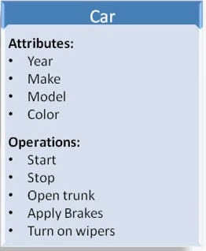
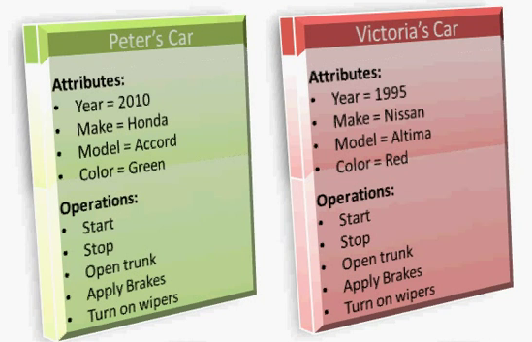
What is a Class
A class can be defined as a blueprint, description,
or definition of a particular classification of objects.
What is an Object
An object (instance) is an instantiation of a class.

Slide 4
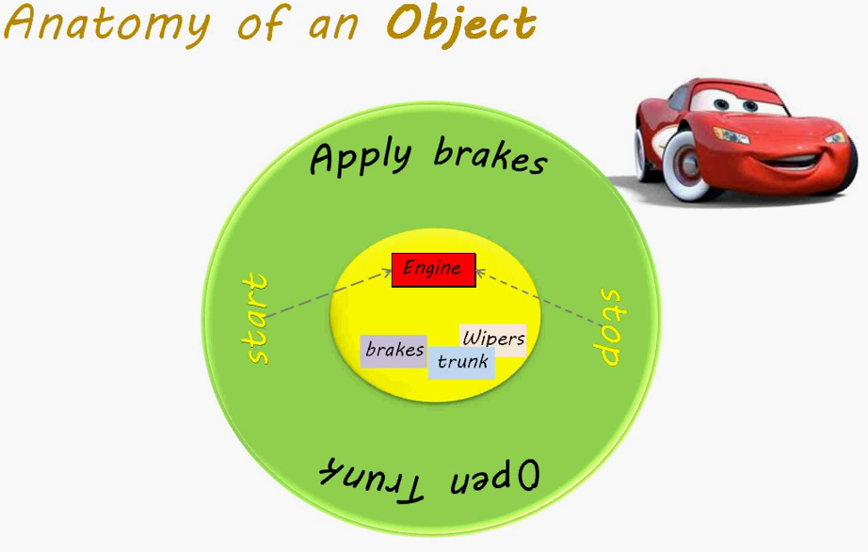

Slide 5
Defining a Class in Python
class classname:
statements.....
class Person: name = str() age = int() def set_details(self, n, a): self.name = n self.age = a def display(self): print(f"Name: {self.name}") print(f"Age: {self.age}") print(f"Is {self.name} an adult?: ",end="")

Slide 6
The __init__ function
The __init__() function/method is called automatically every time the class is being used to create a new object.
class Person: def __init__(self, name, age): self.name = name self.age = age p1 = Person("John", 36) print(p1.name) print(p1.age)

Slide 7
class Person: def __init__(self, name,age,address): self.pangalan = name self.edad = age self.lugar = address
student = Person("John","30","Iloilo City") print(f"My name is {student.pangalan} ") print(f"Im {student.edad} years old") print(f"I live in {student.lugar} ")

Slide 8
Object Methods
Objects can also contain methods. Methods in objects are functions that belong to the object.
class Person: def __init__(self, name, age): self.pangalan = name self.edad = age def myfunc(self): print("Hello my name is " + self.pangalan) p1 = Person("John", 36) p1.myfunc()

Slide 9
Access Modifiers
Python uses ‘_’ symbol to determine the access control for a specific
data member or a member function of a class. Access specifiers in
Python have an important role to play in securing data from
unauthorized access and in preventing it from being exploited.
A Class in Python has three types of access modifiers:
● Public Access Modifier
● Protected Access Modifier
● Private Access Modifier

Slide 10
Private Access Modifiers
The members of a class that are declared private are accessible within
the class only, private access modifier is the most secure access
modifier. Data members of a class are declared private by adding a
double underscore ‘__’ symbol before the data member of that class.
__name = “John Doe”
def __greet():
print(“hello”)

Slide 11
Protected Access Modifiers
The members of a class that are declared protected are only accessible
to a class derived from it. Data members of a class are declared
protected by adding a single underscore ‘_’ symbol before the data
member of that class.
_name = “John Doe”
def _greet():
print(“hello”)

Slide 12
Public access modifiers
All the class members can be accessed anywhere inside or outside the class,
All data members and member functions of a class are public by default.

Slide 13
class Computer: def __init__(self): self.__maxprice = 900 def sell(self): print(f"Selling Price: {self.__maxprice}") def setMaxPrice(self, price): self.__maxprice = price comp = Computer() comp.sell() print("==================") # change the price directly comp.__maxprice = 1000 comp.sell() # using setter function print("==================") comp.setMaxPrice(1000) comp.sell()
Encapsulation
- can restrict access to
methods and variables.
- it prevents data stored
inside the attributes
from direct
modification

Slide 14
Data Encapsulation
Create a class BankAccount that encapsulates the details of a bank account. The class should have the following features:
A private attribute __balance to store the account balance.
A method deposit(amount) to add money to the account. This
method should not allow negative amounts to be deposited.
A method withdraw(amount) to withdraw money from the
account. This method should not allow withdrawal of more
than the available balance or negative amounts.
A method get_balance() to check the current balance.

Slide 15
Test Cases
test_initial_balance:
Create an account with an initial balance of 100.
Check if the balance is correctly set to 100.
test_deposit:
Create an account with an initial balance of 100.
Deposit 50 and check if the balance updates to 150.
Try to deposit a negative amount (-20) and verify that the balance remains unchanged at 150.
test_withdraw:
Create an account with an initial balance of 100.
Withdraw 50 and check if the balance updates to 50.
Attempt to withdraw more than the available balance (200) and verify that the balance remains unchanged at 50.
Attempt to withdraw a negative amount (-20) and verify that the balance remains unchanged at 50.
test_get_balance:
Create an account with an initial balance of 200.
Verify the balance is 200.
Deposit 100 and check if the balance updates to 300.
Withdraw 50 and check if the balance updates to 250.

Slide 16
# parent class class Bird: def __init__(self): print("Bird is ready") def whoisThis(self): print("Bird") def swim(self): print("Swim faster") # child class class Penguin(Bird): def __init__(self): # call super() function super().__init__() print("Penguin is ready") def whoisThis(self): print("Penguin") def run(self): print("Run faster") peggy = Penguin() peggy.whoisThis() peggy.swim() peggy.run()
Inheritance
- creating a new class copying all the details of
an existing class without modifying it
Parent Class (Base Class)
methods
attributes
Derived Class (Child Class)

Slide 17
class Parrot: def fly(self): print("Parrot can fly") def swim(self): print("Parrot can't swim") class Penguin: def fly(self): print("Penguin can't fly") def swim(self): print("Penguin can swim") #common interface def test_fly(bird): bird.fly() def test_swim(bird): bird.swim() #object instantation or object creation chox = Parrot() peng = Penguin() test_fly(chox) test_fly(peng) test_swim(chox) test_swim(peng)
Polymorphism (Many forms)
The ability to use a common interface for accessing
multiple forms
Same method name with different definitions (signatures) being used for different forms.
Interface
Form 1
Form 2
Form 3
Form 4

